Slide 1
Automatic details extraction from Payment cards with OCR and OpenCV
Under the guidence of
Mr. S.N.Chandra Sekhar
Presented by -
Batch no : B-08
K. Yamini - Y15ACS476
M. Umadevi - Y15ACS494
K. Srikar Sharan – Y15ACS462
M. Pradeep - Y15ACS486

Slide 2
Abstract
Payment card OCR is a practical application of image processing which uses credit/debit cards and database to extract the details of accounts owner which are used for payment activities.
This process basically includes the following four steps.
Input
Analyzing and retrieving
Comparing with database
Output

Slide 3
Applications
Online Payment activities.
Application forms in banks
Identifying the owner of lost cards.
Sharing details to depositor just by sending front image. (No need to send CVV)

Slide 4
Requirements
Hardware
Processor speed : 1.0gHz
Ram : 512 MB
Hard Disk : 40GB
Monitor : 15vga colour
Software
Platform : Python
OS: Windows ^{xp} and above..
Tools : Anaconda-(Spyder)

Slide 5
Input & Output
Input -
An front image of credit/debit card which undergoes data compression and image enhancement.
Output -
Basic details of account owner.
(Sensitive data will not be retrieved)

Slide 6
Outline of proposed application
Module 1 : Card number retrieving
Step 1 :- Input of payment card image.
filedialog.askopenfilename()
Step 2 :- Resizing the image.
imutils.resize(img,width=value)
Step 3 :- Converting image to grayscale.
cv2.cvtColor(img, cv2.COLOR_BGR2GRAY)
Step 4 :- Apply TopHat (whitehat).
cv2.morphologyEx(gray, cv2.MORPH_TOPHAT)
Step 5 :- Finding contours.
Step 6 :- Recognizing number.

Slide 7
Cont..
Module 2 : Owner details retrieving
Step 7 :- Comparing with database
Step 8 :- Extracting owner details.

Slide 8
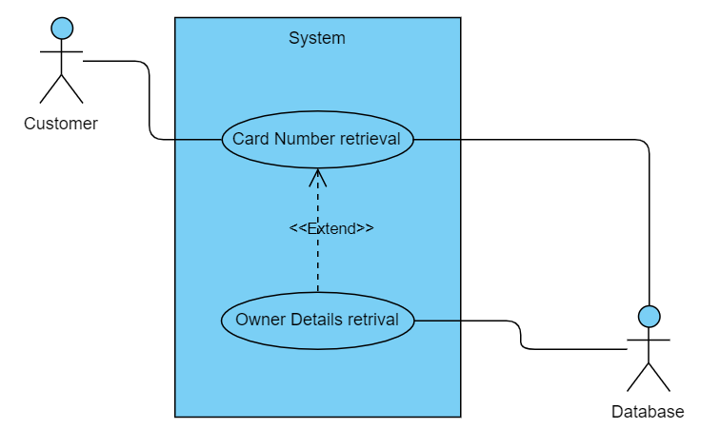
Design phase

Slide 9
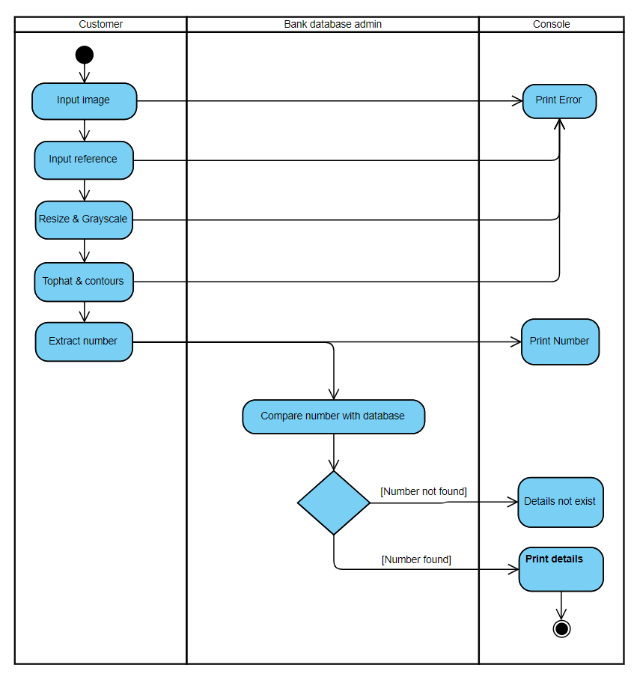
Activity diagram of an application to recognize the number of payment card and extracting its owner details.
[If image invalid]
[If reference invalid]
[If error occured]
[If error occured]

Slide 10
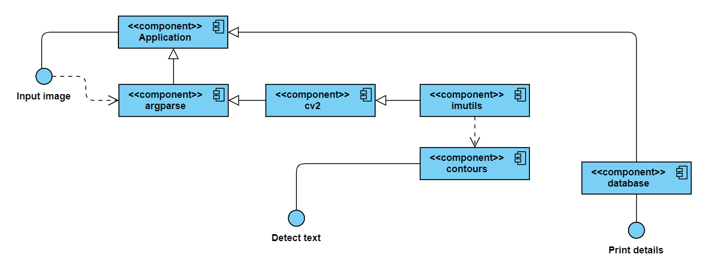
Component Diagram

Slide 11
Coding
filedialog.askopenfilename(filetypes=[("PNG", "*.png"), ("JPEG", "*.jpg"), ("All files", "*")])
…
ref = cv2.imread(args["reference"])
ref = cv2.cvtColor(ref, cv2.COLOR_BGR2GRAY)
…
image = cv2.imread(args["image"])
image = imutils.resize(image, width=300)
gray = cv2.cvtColor(image, cv2.COLOR_BGR2GRAY)

Slide 12
Cont..
tophat = cv2.morphologyEx(gray, cv2.MORPH_TOPHAT)
…
cnts = cv2.findContours(thresh.copy(), cv2.RETR_EXTERNAL, cv2.CHAIN_APPROX_SIMPLE)
…
con = sqlitedb.connect('PaymentCards_DB.sqlite')
cur = con.cursor()
result = cur.execute('SELECT * FROM CARDOWNERDETAILS WHERE CARDNUMBER = ?',(cardnumber,))
for i in result:
print(i)

Slide 13

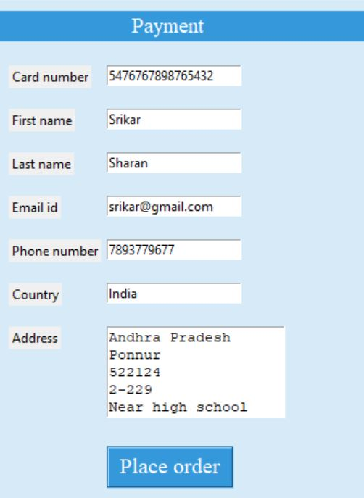
Result Analysis

Slide 14
Advantages
Increases the efficiency and effectiveness.
Instantly search through details.
Quick, Accurate and Ensuring.
No waste of time in typing whole details in payment activities.
Relaxed alignment in mobiles.

Slide 15
Conclusion
There is an immediate need of such kind of payment cards details retrieval system in India as there are some issues of time killing payment forms, lost cards etc.
Government should take some interest in developing this system as this system is very economical and eco-friendly, if applied effectively .
This change will help in the progress of the nation.

Slide 16
Thank you!

